Slide 1
JavaScript DOM
Manipulation & Traversal

Slide 2
Outline
Introduction to the DOM
Selecting Elements
Manipulating the DOM
Traversing the DOM

Slide 3

DOM

Slide 4
Document Object Model
DOM stands for the Document Object Model. It is a browser’s structured, in-memory representation of an HTML page.
It acts as the Programming AIP for HTML and XML documents
The DOM enables JavaScript to access and manipulate elements and styles of a webpage.
Note: The DOM is provided by the browser environment, not JavaScript itself. As such DOM code does not work in non-browser environments (like Node.js – more on this later) without additional tooling.
The web browser updates this DOM actively as elements are modified.

Slide 5
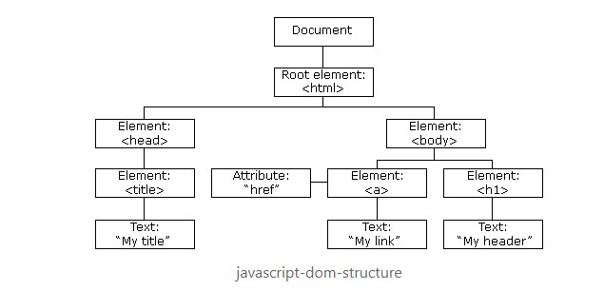
Document Object Model
When a browser loads an HTML file, it parses the markup and constructs the DOM as a tree of objects that JavaScript can read and manipulate.
The tree is made of nodes – every element, attribute and piece of text in the document is a node.
The top of the tree is the document object.
The root element of the node is the <html> element

Slide 6
Selecting Elements

Slide 7
Finding DOM Elements
JavaScript must locate elements within the DOM to determine the target of potential modification.
JavaScript includes many methods to locate elements based on attributes or other criteria, including:
Finding element using ID
Finding elements using Tag Names
Finding elements by Class Names
Finding elements by CSS Selectors
Finding elements by HTML Object collections
More…

Slide 8
Single Element Selectors
Single element selectors will return a single element.
document.getElementById(id): selects a single element by it’s id attribute. This returns either the element or null if not found.
Note: technically this will return the first element with the matching ID, but remember the Id should be a unique value across your webpage.
document.querySelector(selector): selects the first element that matches any valid CSS selector. This returns the element or null if none were found.

Slide 9
Multiple Element Selectors
document.getElementsByClassName(className): returns a live HTMLCollection of all elements within the given class
document.getElementsByTagName(tagName): returns a live HTMLCollection of all elements with the given tag name
A live HTMLCollection updates automatically if the DOM changes after the query – the collection always reflects the current state of the page.
document.querySelectorAll(selector): returns a static NodeList of all elements matching a CSS selector.
A static NodeList is a snapshot taken at the moment of the query – it does not update if the DOM changes afterward.
Note: the NodeList returned from querySelectorAll() support forEach() operations directly, but an HTMLCollection does not – it must first be converted to an array with Array.from() to be used with Array Methods.

Slide 10
Manipulating the DOM

Slide 11
Reading & Modifying Element Data
innerHTML gets or sets the full HTML content inside an element, including any child tags.
Note: This can be used to inject HTML markup directly
textContent gets or sets the plain text content of an element.
Note: This ignores any HTML tags so it is safer than innerHTML when working with user-provided content.
getAttribute(name): reads the current value of a specified HTML attribute (e.g. src, href, alt)
setAttribute(name, value): adds or updates an attribute on an element
removeAttribute(name): removes an attribute from an element entirely

Slide 12
Creating & Removing Elements
document.createElement(tag): creates a new element in memory. It is not added to the page until explicitly done so.
parent.appendChild(element): adds a new element as the last child of a parent element.
parent.prepend(element): adds a new element as the first child of the parent element
element.insertAdjacentElement(position, newElement): inserts an element at a precise position relative to an existing one.
Positions are: “beforebegin”, “afterbegin”, “beforeend”, “afterend”
element.remove(): removes the element from the DOM
parent.removeChild(element): removes a specific child element from a parent.
Note: this is an older pattern, but is still seen commonly

Slide 13
Traversing the DOM

Slide 14
Traversing the DOM | Parent Traversal
element.parentNode: returns the parent node of an element. Can return any node type, including document nodes.
element.parentElement: returns the parent element; specifically returns null of the parent is not an element
In practice, parentElement is preferred since it is a more predictable way to get actual elements that we would manipulate.
element.closest(selector): traverses upward through the element’s ancestors and returns the first match for a given CSS selector
Returns null if no ancestor matches
Note: closest() starts its search on the element itself before moving update. This means the element is included as a candidate for the search.

Slide 15
Traversing the DOM | Child Traversal
element.childNodes: returns a live NodeList of all child nodes, including text nodes and comment nodes, not just elements.
element.children: returns a live HTMLCollection of child elements only (text nodes and comment nodes are excluded.
element.children is almost always what you want when working with DOM.
element.firstChild/lastChild: returns the first / last child node
element.firstElementChild/lastElementChild: returns the first / last child element – preferred over firstChild/lastChild
element.childElementCount: returns the number of child elements as an integer

Slide 16
Traversing the DOM | Sibling Traversal
element.nextSibling: returns the next node in the parent’s child list (this may be text or a comment node)
element.previousSibling: returns the previous node in the parent’s child list.
element.nextElementSibling: Returns the next sibling that is an element. Preferred over nodes.
element.previousElementSibling: Returns the previous sibling that is an element. Preferred over nodes.
All sibling properties return null if no matching sibling exist in that direction

